Slide 1
MIS 632-A: Data Management Lab
Week 5: SQL Part 2
Mengfang Sun
msun7@stevens.edu

Slide 2
Agenda
JOINS

Slide 3
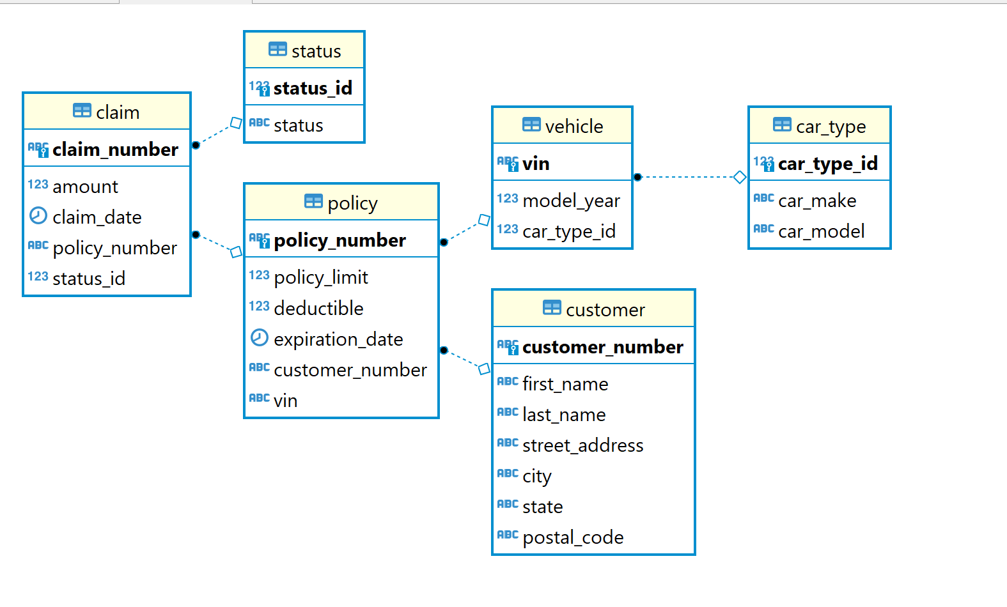
Insurance Claims DB ER Diagram

Slide 4
JOINS
INNER JOIN
Return only columns that contain the key in BOTH tables
SELECT <columns>
FROM Table1 INNER JOIN Table2
ON Table1.key1 = Table2.key2;
LEFT OUTER JOIN
Return ALL columns from left table and only matching tables from right table
SELECT <columns>
FROM Table1 LEFT JOIN Table2
ON Table1.key1 = Table2.key2;
RIGHT OUTER JOIN
Return ALL columns from right table and only matching tables from left table
SELECT <columns>
FROM Table1 RIGHT JOIN Table2
ON Table1.key1 = Table2.key2;

Slide 5
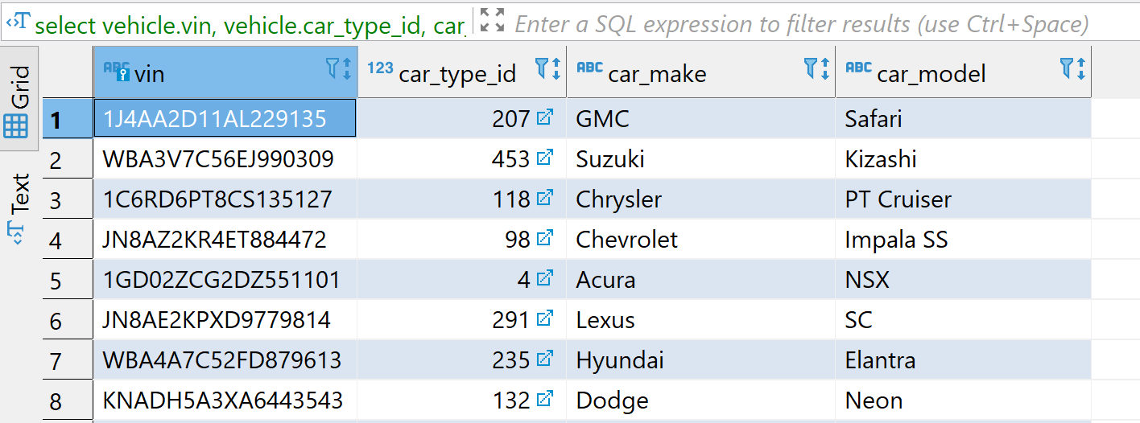
INNER JOIN Example
select vehicle.vin, vehicle.car_type_id, car_type.car_make, car_type.car_model
from vehicle inner join car_type
on vehicle.car_type_id = car_type.car_type_id;
tableName.Column avoids ambiguity when more than one table in a join has a column of the same name

Slide 6
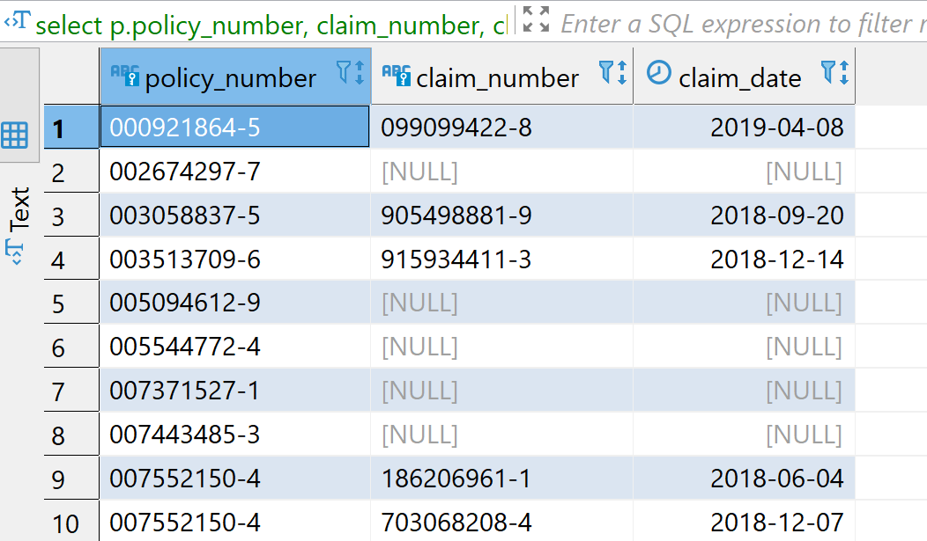
LEFT JOIN Example
p.policy_number specifies pulling policy_number from policy table
select p.policy_number, claim_number, claim_date
from policy p left join claim c on p.policy_number = c.policy_number
order by policy_number;
“c” is a short-hand for the claim table
NULL value means there is record in the claim table for this policy
Notes:
TableName.Column is like a person’s first and last name
If you only know one Tom, you can simply refer to him as Tom
But if you know two or more Toms, you need to use their last names to specify WHICH Tom (or at least their last initial)

Slide 7
Homework Assignment
Use the insurance claims database you created for the week 3 homework assignment to answer all questions in this assignment.
For each question in this assignment, provide the following:
SQL query
Table of data showing query results
Questions:
What is the customer information for customers who live in Los Angeles?
What is the average value of all approved claims?
Two parts:
What are the top 5 policies by claim count?
What are the top 5 policies by total claim amount?
What is the vehicle identification number (VIN) and model year for cars with a policy expiration date after October 31, 2019 and a model year of 1985 or earlier?
List the cities in New York or New Jersey where customers who have policies with NO claims live.
HINT: Do not list a city more than once, even if multiple customers live in that city.

Slide 8
Homework Submission Format
What are the top 5 postal codes by policy count for customers who live in the District of Columbia?
select postal_code, count(*) policy_count
from policy p
inner join customer c on p.customer_number = c.customer_number
where state = 'District of Columbia'
group by postal_code
order by policy_count desc
limit 5;

